Slide 1
uProcesoru sistēmu projektēšana un skaņošana
Piezīmes
Notes

Slide 2
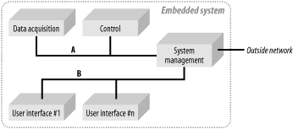
Example of control uProc system. Most common case
Each component is an individual embedded system.
Control system is composed of networked computers.
Different components grouped and interconnected via system control module, being interface to “outside world”.

Slide 3
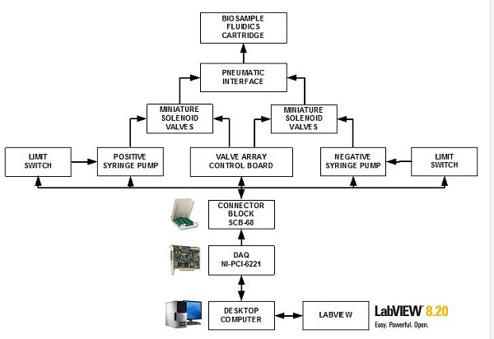
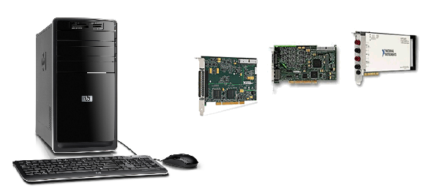
Data Acquisition Module
The first in process measurement are transducers – convert phy. phenomenon into electrical sig.
Elec. signals from transducers often go through stages of signal conditioning before DAQ module.
DAQ (e.g. card in desktop controller via Comedi) samples and converts elec. sig. to digital form and stores values in sample buffer(s).
Software use these values to plot curves, analysis and control parameter modification.
The desktop is concerned as a medium-sized embedded system with stringent time constraints and no user interface, while being connected to the rest system via Ethernet.

Slide 4
Data Acquisition Module. Operations
DAQ operations:
Stores data in local buffer
May analyze:
On site with further data/critical exchange with SYSM
Send data to SYSM for whole analyze
DAQ carry out commands from SYSM
DAQ exchanges with configuration and status with SYSM periodically or on-demand basis.

Slide 5
Data Acquisition Module. Construct
DAQ typically boots from some sort of flash and uses RAM disk or CRAMFS (compressed ROM file system) - easy replicable if needed.
DAQ doesn’t provide such services as FTP, HTTP or NFS.
Instead runs daemon(-s) to communicate with SYSM.
DAQ has only minimal support for user tools, like BusyBox package.
DAQ utilizes fixed IP address thus SYSM may check if it is available and its status at any time.

Slide 6
Control Module
Because PLCs and similar systems are expensive, moreover run their own OSes, need special configuration procedures, usage of mainstream HW (PCs) becoming more common in process control.
The control module (CM) is an industrial computer with an interface to the HW being controlled.
The computer runs medium-sized embedded system with stringent time-constraints and with no user interface, like DAQ.
Is connected to the rest of the system via Ethernet link.

Slide 7
Control Module. Operations
The CM’s main task is to issue commands to HW it controls, while monitoring the progression of the hardware’s behavior in reaction of the commands.
Typically control commands are issued from the SYSM. And they are connected to DAQ module output.
The CM coordinates the HW to execute SYSM issued commands.
The CM exchanges with an info with SYSM:
Upon request;
Operation is completed;
Any special situation occurs.

Slide 8
Control Module. Construct
CM typically boots from some sort of flash and uses RAM disk or CRAMFS (compressed ROM file system) - easy replicable if needed.
The PC runs a kernel configured for preemption along with a real-time kernel, such as RTAI or RTLinux.
Hard real-time response times are necessary to control complex HW. Thus hard real-time drivers are used for that HW control.
No outside communication, too. Only custom daemons communicates with SYSM. Uses fixed IP address, too.

Slide 9
System management module
Main tasks:
Coordinate interactions between components;
Providing a point of entry to the sys. from outside world.
It is a large embedded system with no UI.
Contains three network adapters with different rules:
DAQ and CM;
UIs;
Outside world.

Slide 10
System management module. Links’ overview
SYSM retrieves data from DAQ
Stores the data + may run backup procedures to store the data in local database.
Sends pertinent data to UIs for display.
Whether the analysis done in DAQ or SYSM the control commands are issued to CM.
On outside network SYSM provides HTTP and SSH services. For monitoring, controlling and configuration purposes.
Provides means to report an end-user on alar condition via SNMP, UIs.
On link B SYSM offers DHCP so UIs can dynamically allocate their addresses.
UIs must register themselves with the SYSM to receive data to work with.

Slide 11
System management module. Construct
SYSM is a large embedded system.
Utilizes HDD for boot off. Becomes more likely as workstation computer.
SYSM kernel is configured for preemption, too.
As well multiuser support is introduced since SYSM is addressed from different sources.
The filesystem is the same as in workstations and servers.

Slide 12
User Interface modules
UIs are used to interact with ongoing process:
Viewing its state;
Modifying variables that control the process.
UIs are small embedded systems, network enabled and may be mobile;
UIs retrieves and displays values from SYSM:
Critical values are displayed always;
Users may choose which variables they want to see.

Slide 13
User Interface modules. Construct
UI is a small module which boots from:
Flash;
Network.
IP address is obtained via DHCP;
Especially mobile UI are built on ARM, MIPS architecture processors.
UI run standard kernels with additional graphics library.

Slide 14
Design and Implementation. Creating a Target Linux System
Determine system components
Is close to a simple list of required components.
Need to have Linux’s compliance to these requirements.
In case of feature updates – you should know that it may result in retesting of whole system with undefined errors.
Configure and build the kernel
Keeping kernel up-to-date is a good practice – get rid of errors in kernel. Old kernels are not supported by community.
Keep the kernel configuration constant.
Build root filesystem:
Embedded Linux has size limited filesystem.
Set up boot software and configuration
Booting is highly dependent on the architecture.

